Slide 1


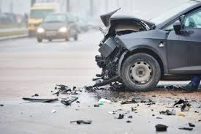
CAPSTONE PROJECT ON INVESTIGATION OF ROAD ACCIDENT
Prepared by Farooq Shaikh
Under The Guidance of
Mr. Rithik Raj

Slide 2
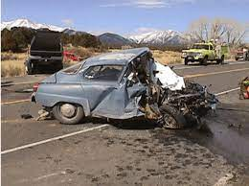
Introduction :
Every year, road traffic accidents result in countless injuries and mortality, making road safety a critical concern globally.
Predicting the severity of car accidents is a essential step towards improving emergency response systems and implementing preventive measures.
In this project, we aim to develop various classification model that can predict the severity of car accidents based on various contributing factors.

Slide 3
Dataset :
This dataset includes a wealth of information, such as weather conditions, road conditions, and the presence of pedestrians or cyclists, collected at the time of the accident.
The dataset contains 38 features and 194,673 rows. The dataset consists of many columns containing both categorical and numeric data and gives detailed descriptions of keys provided for each type of incident.
The features I am going to be working with are SEVERITYCODE, ADDRTYPE, COLLISIONTYPE, PERSONCOUNT, PEDCOUNT, VEHCOUNT, WEATHER, ROADCOND, LIGHTCOND, SPEEDING, INATTENTIONIND, UNDERINFL.
The target variable is "Severity," which categorizes accidents into mild or severe.

Slide 4
Objective :
The primary objective of this classification project is to build a classification model to predict the severity of car accidents based on various contributing factors.
Explore and analyze the car accident severity dataset to gain insights into the distribution of features, potential patterns, and outliers.
Clean and preprocess the dataset to handle missing values, outliers, and categorical variables, ensuring it is ready for model training.
Identify and select the most relevant features that significantly contribute to predicting car accident severity.
Utilize classification algorithms (e.g., Decision Trees, SVM, KNN) to train a predictive model.
Evaluate the model's performance using appropriate metrics such as accuracy, precision, recall, and F1-score.

Slide 5
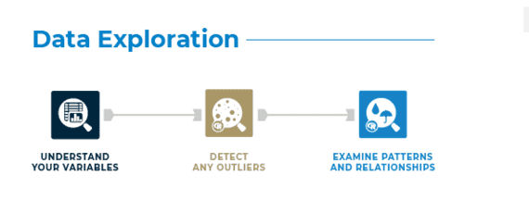
Data Exploration
Data exploration is a crucial step in understanding the characteristics of your dataset before building a classification model.
It helps you understand your dataset, identify patterns, and prepare the data for modeling.
Data exploration steps includes importing the libraries, loading the dataset and initial data examination.
Data exploration steps provide a basic understanding of the dataset and help guide further preprocessing and model building decisions.

Slide 6
Data Preprocessing
Data preprocessing is also a crucial step to clean and transform your data into a format suitable for building a classification model.
Data preprocessing involves cleaning, transforming, and encoding the data so that it can be used effectively for training and testing the model.
This step includes :
Handling missing values: Depending on the dataset, imputing missing values using mean, median, bfill and ffill methods.
Normalize or scale features, to ensure that all features have a similar scale.
Converting categorical variables into numerical representations.

Slide 7
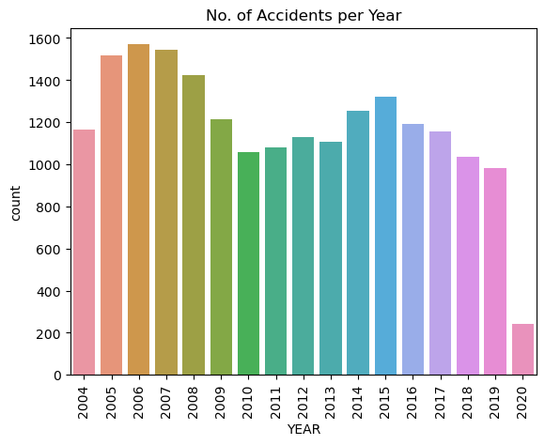
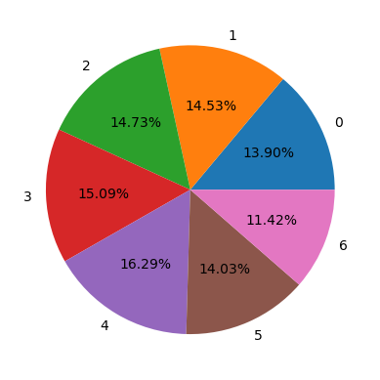
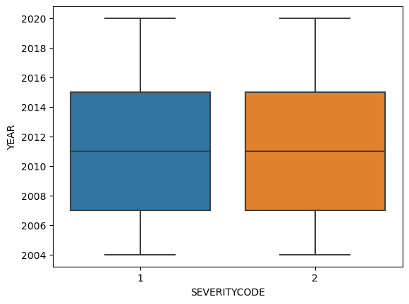
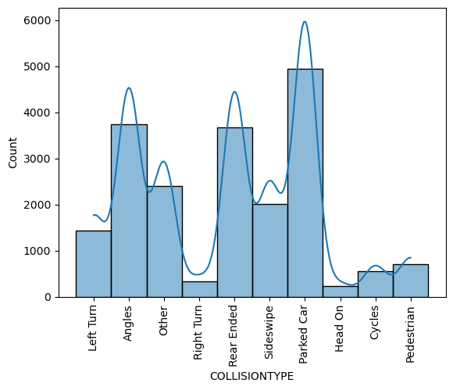
Exploratory Data Analysis (EDA) :
Exploratory Data Analysis (EDA) is an important step in understanding the characteristics of your dataset and gaining insights into potential patterns, relationships, and outliers.
The visualizations provide insights into the distribution of features, potential correlations, and the impact of various factors on accident severity.
Visualizing various factor can help us to understand which factors can lead to be accident.

Slide 8
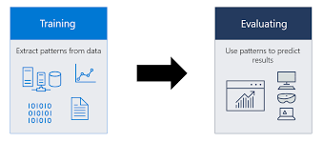
Model Building
Model building involves selecting a suitable algorithm, training the model on the training dataset, and evaluating its performance on a separate test dataset.
In this project, we have builded several classification model such as
Logistic Regression
Support Vector Machines (SVM)
k-Nearest Neighbors (KNN)
Decision Tree

Slide 9
Model Evaluation
In this project, we have assessed the performance of our model by using appropriate classification metrics such as accuracy, precision, recall, F1-score, classification report, confusion matrix and ROC curve analysis.
Accuracy is the proportion of correct predictions over total predictions.
Precision measures how good our model is when the prediction is positive.
Recall measures how good our model is at correctly predicting positive classes.
F1 score is a machine learning evaluation metric that measures a model's accuracy. It combines the precision and recall scores of a model.
The ROC AUC score tells us how efficient the model is.
A classification report provides a summary of various metrics that describe the model's performance, such as precision, recall, and F1-score.
A confusion matrix is a table that is used to define the performance of a classification algorithm.

Slide 10
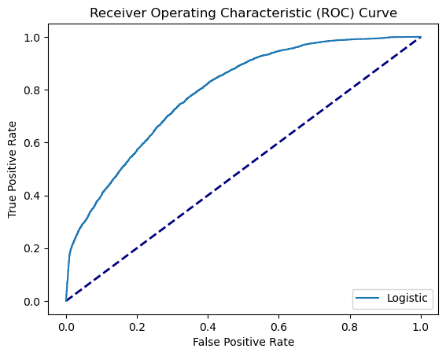
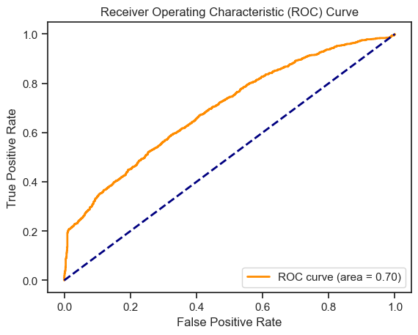
ROC Curve of Logistic Regression
ROC Curve of SVM

Slide 11
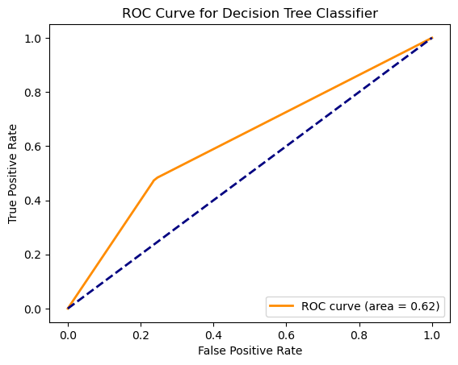
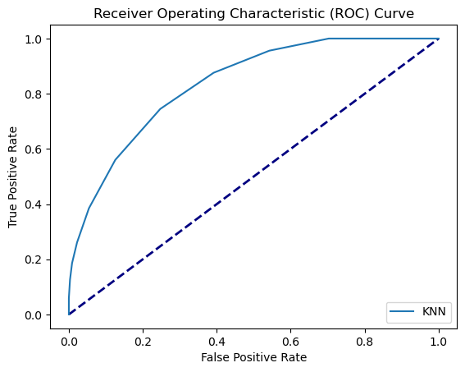
ROC Curve of Decision Tree
ROC Curve of KNN

Slide 12
Accuracy Table
Model | Accuracy | F1 Score
Logistic Regression | 75.575% | 84.4501%
K-Nearest Neighbor | 73.75% | 82.8823%
Support Vector Machine | 75.225% | 84.5951%
Decision Tree | 68.175% | 77.1741%

Slide 13
Conclusion
After performing different types of algorithm on the dataset we could see that each algorithm's model perform differently in order to classify the data and providing accuracy of doing the same.
From our readings we can see that Logistic Regression has shown the highest accuracy and a fairly good f1 score. Therefore we can conclude that Logistic Regression is what works best for this model.
The project has provided valuable insights and a well-performing model for predicting car accident severity.
The knowledge gained from this project has the potential to contribute significantly to road safety measures and emergency response efforts.

Slide 14
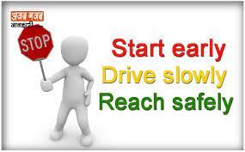


Thank You!

